Slide 1

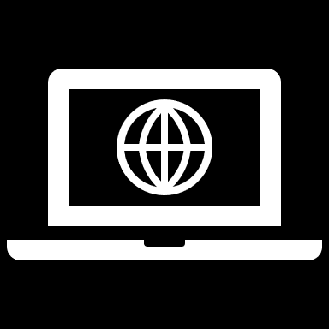
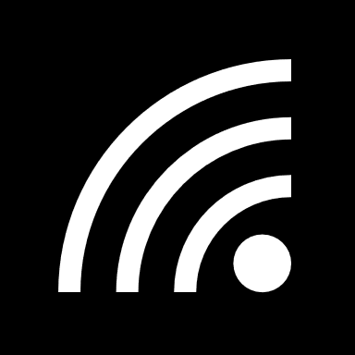
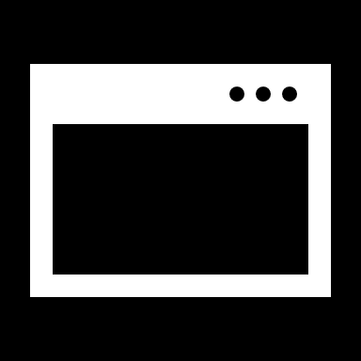
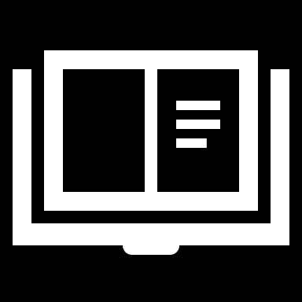
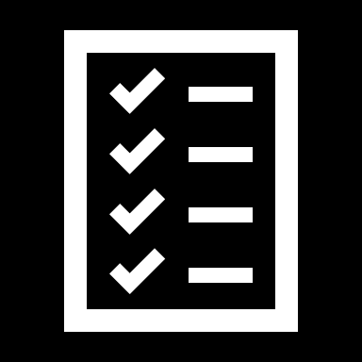

The MU Virtual Classroom
Team Members
19XJ1A0572 Sneha Potluri
19XJ1A0562 Sahithi Josyula
19XJ1A0523 E. Manushree
This Photo by Unknown Author is licensed under CC BY-SA

Slide 2
Objective and targeted problems - A one-stop online portal to access coursework and academics
Especially during the coronavirus pandemic, online platforms have proven to provide an enhanced academic experience for students and faculty.
It can get chaotic to keep track of course materials, projects, schedules and deadline without an application like this.
This is an attempt at creating a virtual platform that encompasses all academic schedules and coursework ensuring a holistic online learning experience.
We’ve designed an application that enables the academic community at MU to have an uncomplicated mechanism while accessing academics.
Notes:
sahithi

Slide 3
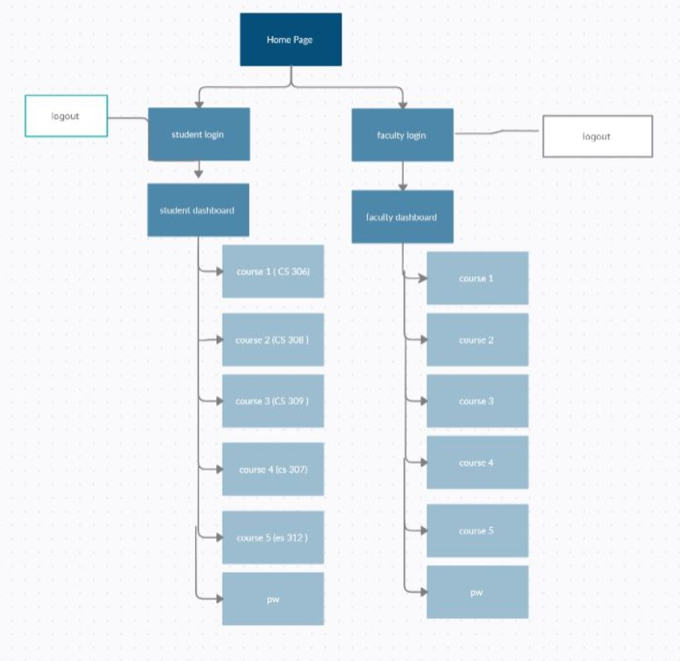
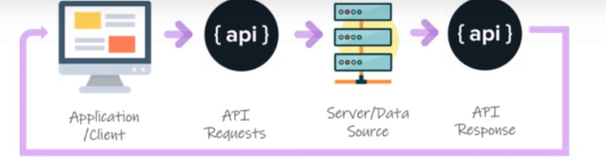

Slide 4


Features - Students
View respective courses according to specific year and branch by switching between tabs.
Access all course material uploaded by professors.
View a list of assignments and deadlines for each course. Can also upload assignments from their local files which can be viewed dynamically by the faculty members.
View schedules with the “view timetable” button.
View list of upcoming events and examinations.
View grades awarded by the professors.
Notes:
sahithi

Slide 5


Features - Faculty
Access to respective courses by switching subject tabs
Can view timetables and plan their day accordingly.
Change and assign grades to students, which are reflected on that student’s page.
Upload course material, assignments, and homework for each course. This can then be viewed by the students taking that course.
View upcoming events and meetings.
Notes:
sneha

Slide 6
Contributions
Sneha - Faculty and assignment tables
Sahithi - Student signup and login, materials, and faculty login tables
Manushree - Student tables

Slide 7
OVERCOMING CERTAIN CHALLENGES WITHOUT A DATABASE
-> Previously , we had created a self sustaining java project with the gui interacting with array lists and a student class that stored temporary data .
-> This was still lacking in terms of data being lost once the user closes the application. It was a temporary place holder for the purpose of demonstration.
-> now , we’ve combined tables within data bases and integrated them with the help of certain python apis to holistically connect the front end as well as the backend/database.
-> Data can be permanently stored and displayed with the help of a database .

Slide 8
Why use Postgresql?
It is an advanced open-source object-relational system which applies SQL language. Postgres allows you to store large and sophisticated data safely. It helps developers to build the most complex applications, run administrative tasks and create integral environments.

Slide 9
Dynamic Functionality
The students are allocated their courses based on the year and branch they choose.
Then, they can view all material related to these courses.
The professors can add course material and assignments for each course they teach.
These will be reflected on the student dashboard of those students who take that particular course.
The professors can view a list of all students registered so far and assign grades. Students can view their grades.

Slide 10
CONNECTIVITY (API endpoints)
--> /hello/
this api is use to test the api status it has GET and POST methods
-->/student/login/
this api is used to verify the student login. It takes roll number and password as arguments and verifies if the student is registered by scanning the student database.
Arguments: -> password
-> Rollnum
--> /student/signup/
this api is used to create a new student user using GET AND POST methods
it takes the student details as arguments and sends it to DB connector to store it into the database
Arguments: -> rollno
-> name
-> password
-> year
-> branch
--->/student/getall/
This api uses the .GET method
Arguments: ->name
-> rollnum
-> year
-> grade

Slide 11
—> /Faculty/login/
This api uses the GET and POST method
Arguments : It takes the faculty details from the database and checks the faculty credentials
-> password
-> eid
—--> /assignments/
This api uses the POST method in order to add items/ assignments to the inventory as a faculty member.
Arguments: it takes the assignment details and stores it in the assignment table.
-> Subcode
-> title
-> description
-> deadline
—>/assignments/
This api uses the GET method in order to retrieve data from the assignments table.
Arguments: it verifies with the subcode and displays data
—>subcode
—--> /materials/
This api is used with a GET function to retrieve information from the materials table in order to display data.
Arguments: it uses subcode to verify
—> subcode
—---> / materials/
This api uses the POST function to add data into the materials table
Arguments: -> subcode
-> filename
-> date

Slide 12
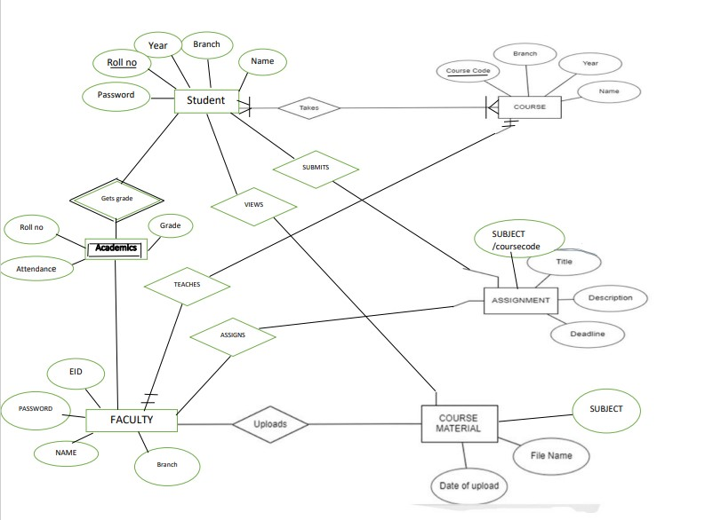
ER Diagram

Slide 13
Relationships as shown in the ER Diagram
For each student, faculty, course, assignment and material, we create an object of their respective class.
All objects are maintained in array lists for easy access.
This structure allowed us to create relationships between different objects.
For example, each student object has a list of course objects as an attribute.
Similarly, each course has a list of assignments and material objects associated with it.

Slide 14
Limitations
Our application doesn’t work in fullscreen as of now.
It doesn’t have delete, sort and search functionalities. Although these are fairly simple to implement, our GUI doesn’t support it.
Notes:
sahithi

Slide 15
Extension of Work
Admin access - To add new courses, create logins for faculty, add new events to the event schedule.
Doubt clearing- Students can send doubts to professors and they can reply back to clear it.
Schedule meetings between students and professors.
Conducting examinations using this portal.
We plan to add delete, sort, search, etc functionalities by adding buttons in our GUI and then writing simple code for it.
Notes:
sneha

Slide 16
Conclusion
This project has been a great way for us to combine all that we learnt in our OOP course and DBMS course and apply those concepts.
We wish to add additional features to our project to extend its scope of use.
We want to improve this application, and maybe eventually develop this project further for use by the students of MU.
Screenshots ahead
Notes:
sneha

Slide 17
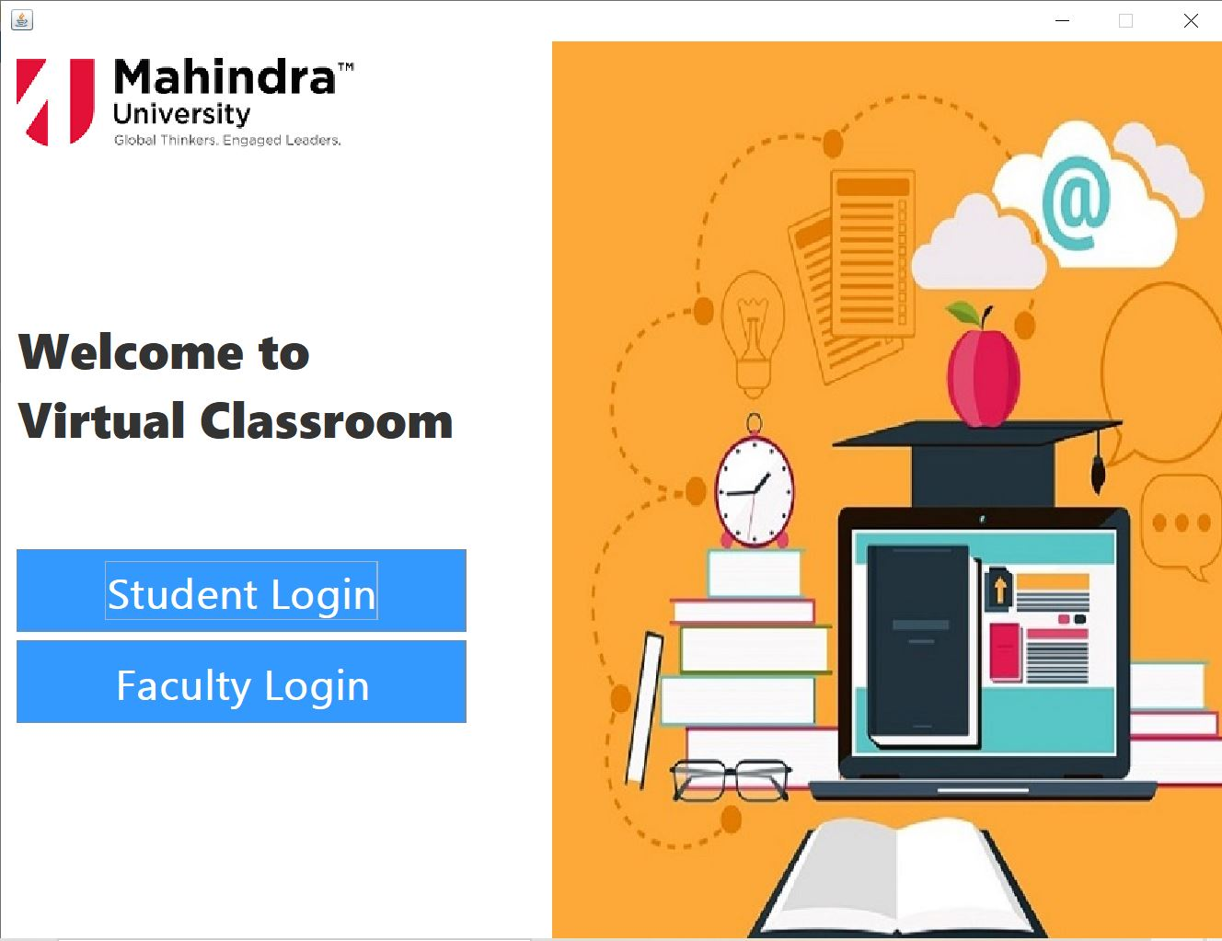
Home Page

Slide 18
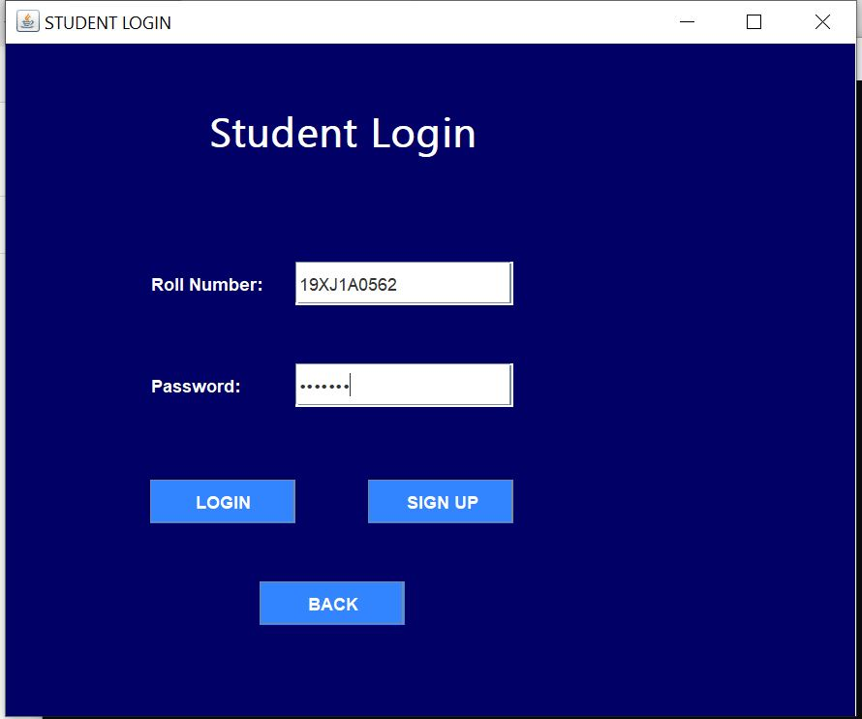
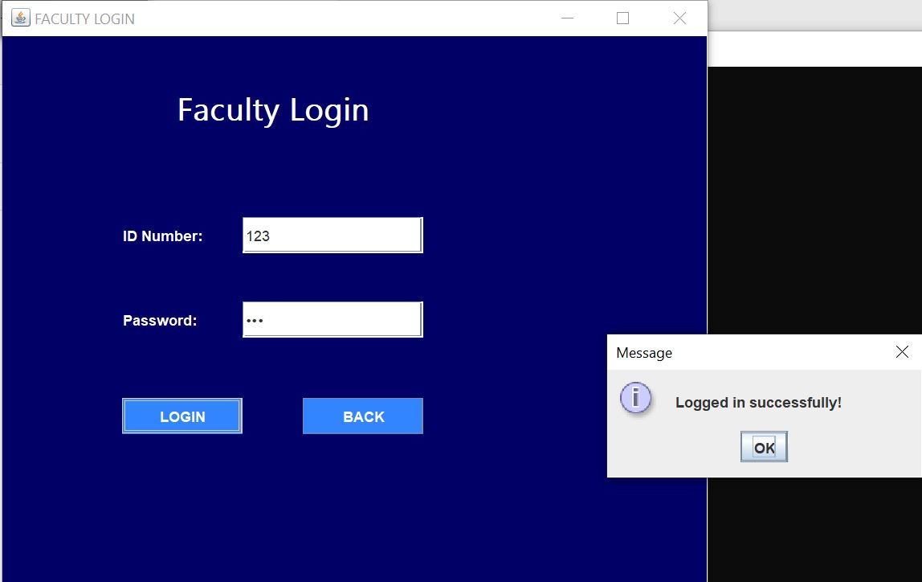
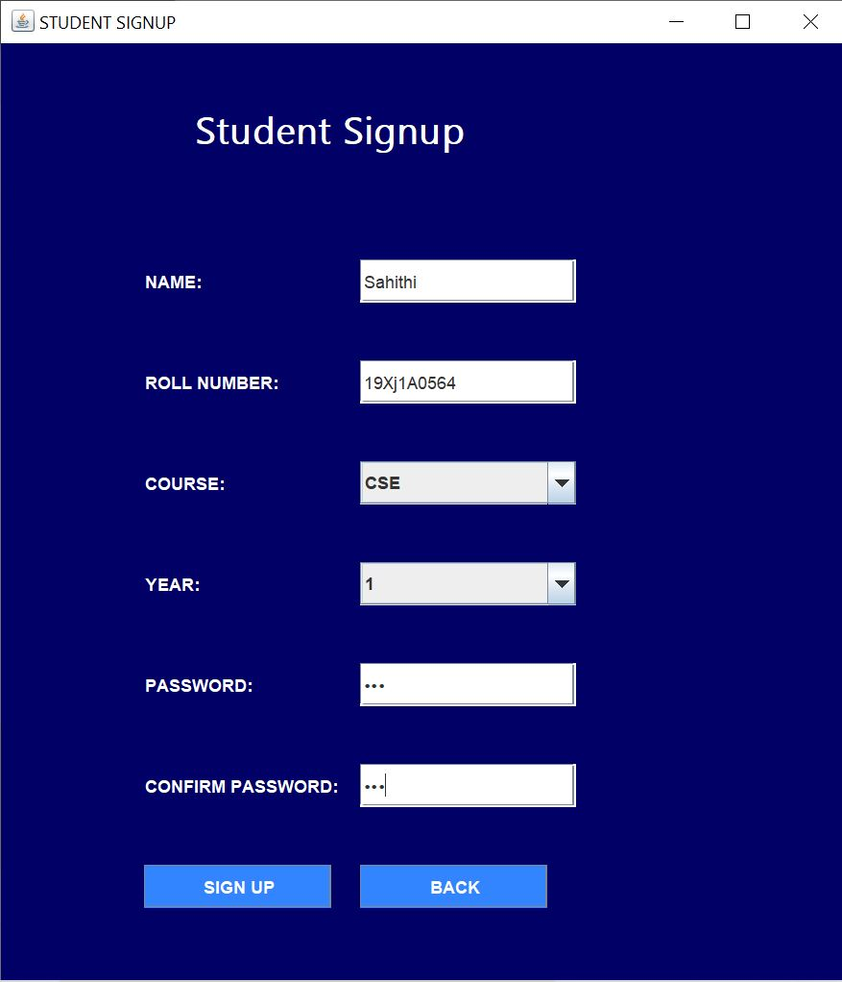
Login and Sign up Pages

Slide 19
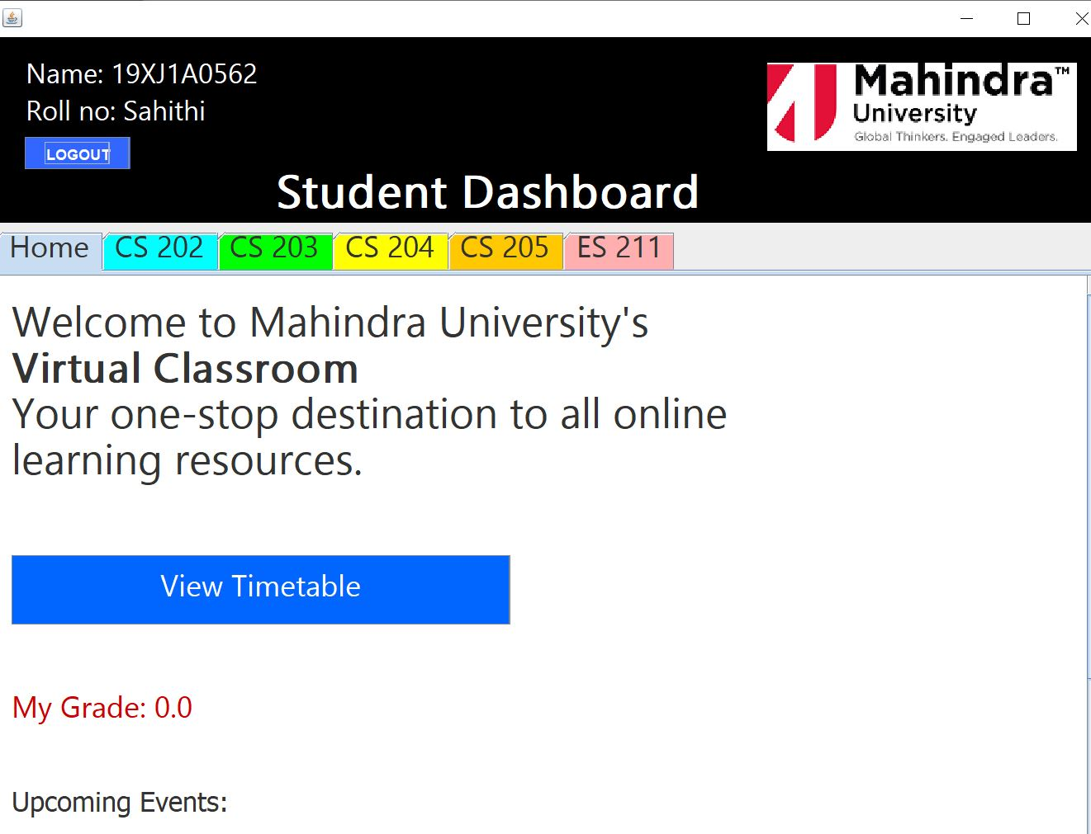
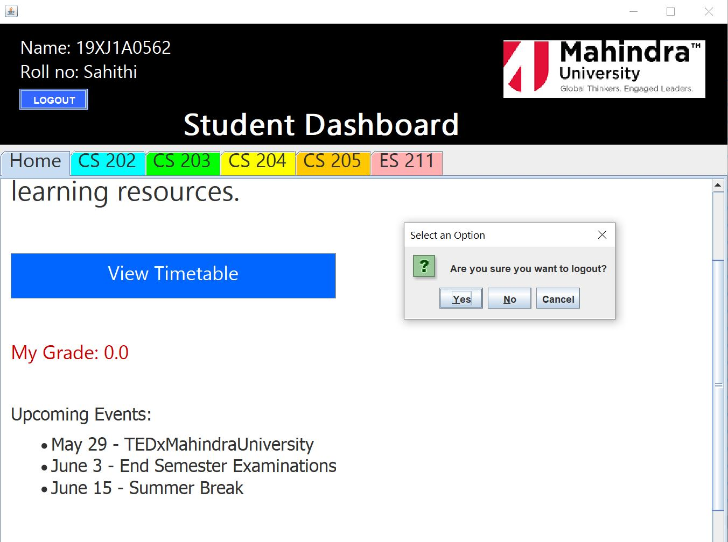
Student Dashboard For a CSE Student

Slide 20
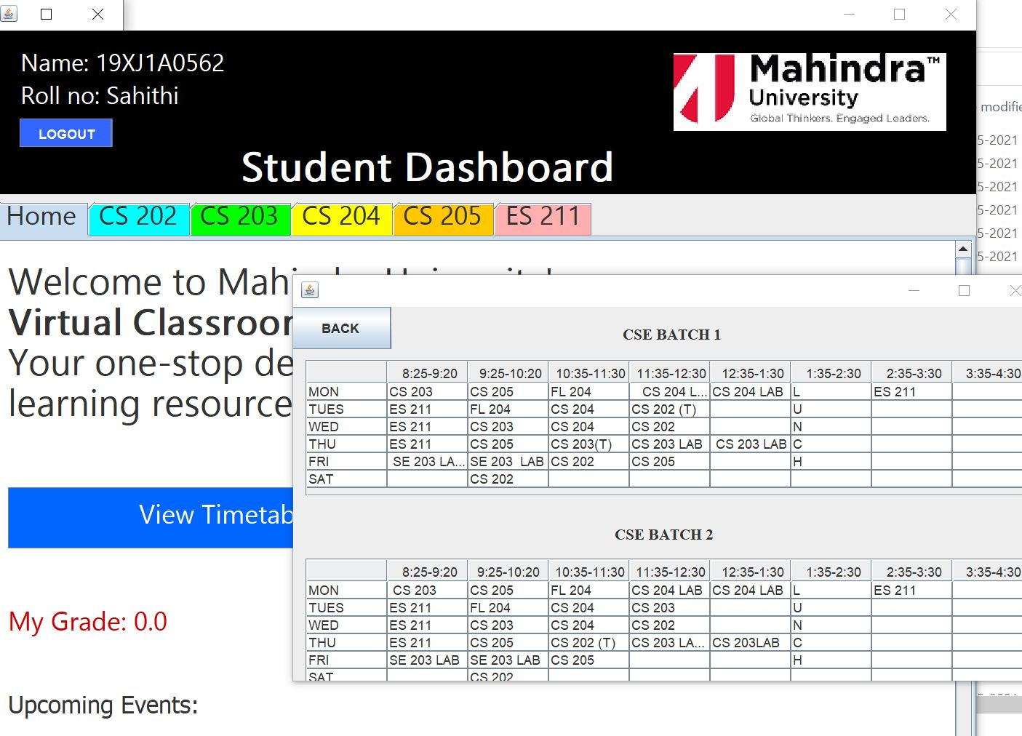
Time Table Displayed when “View Timetable” button is clicked

Slide 21
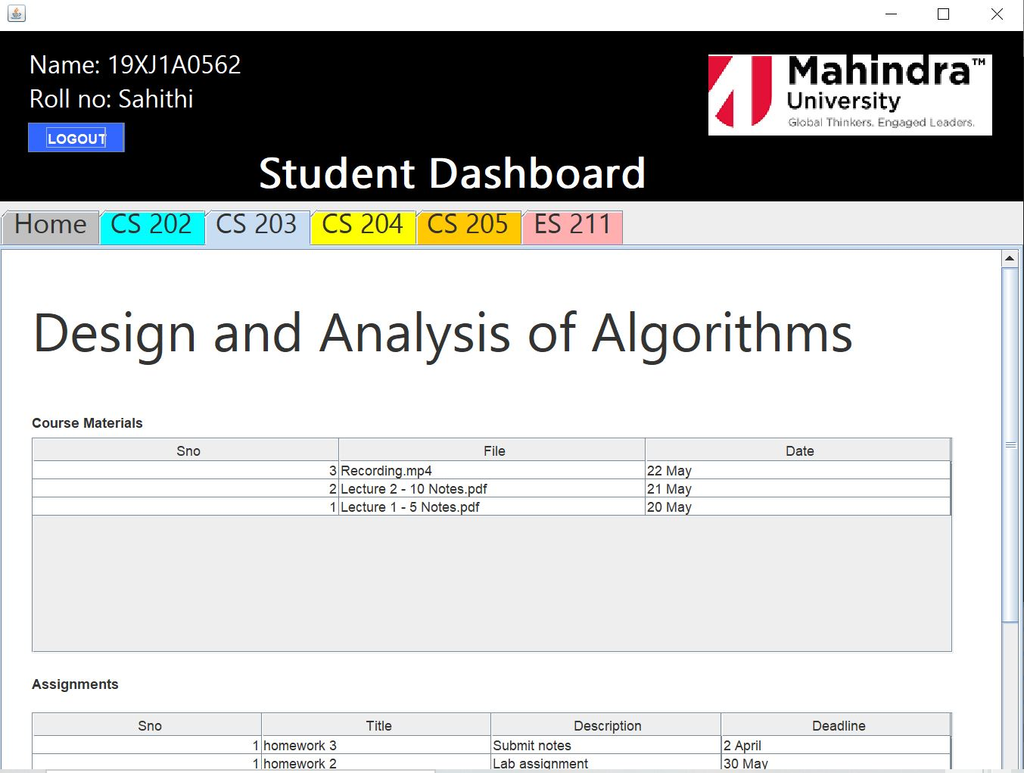
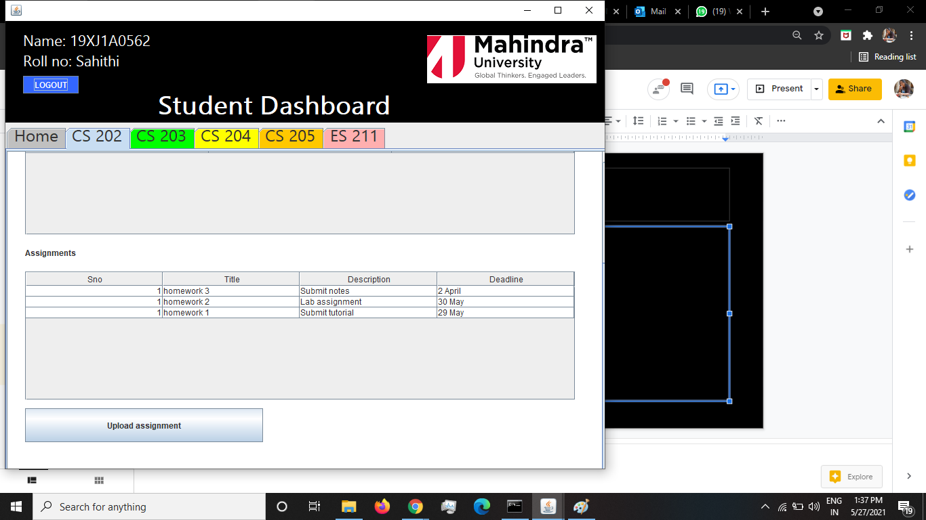
Student Courses

Slide 22
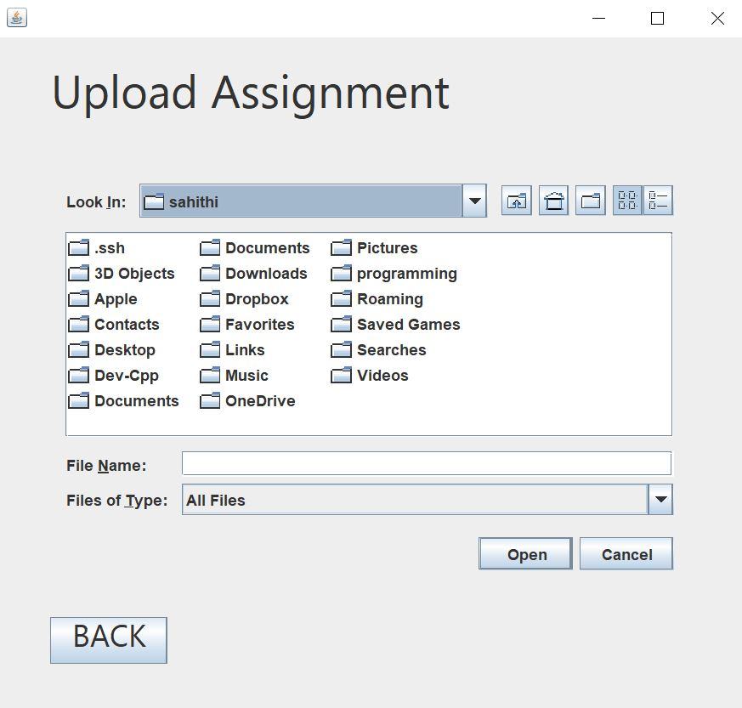
Upload assignment pop up window

Slide 23

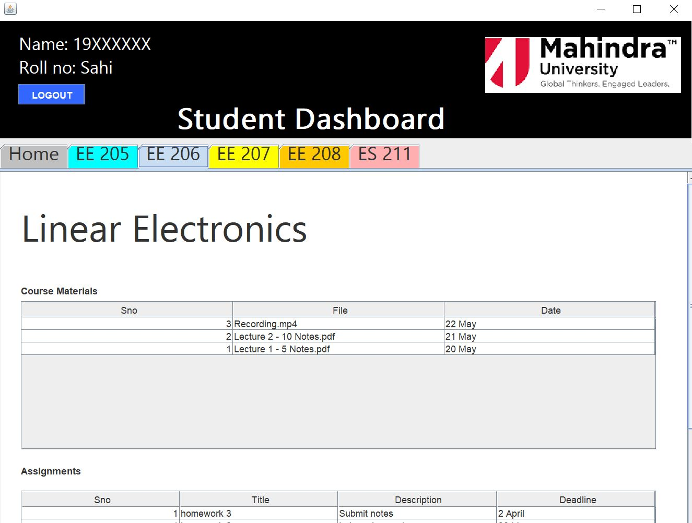
Student Courses For a EEE student

Slide 24
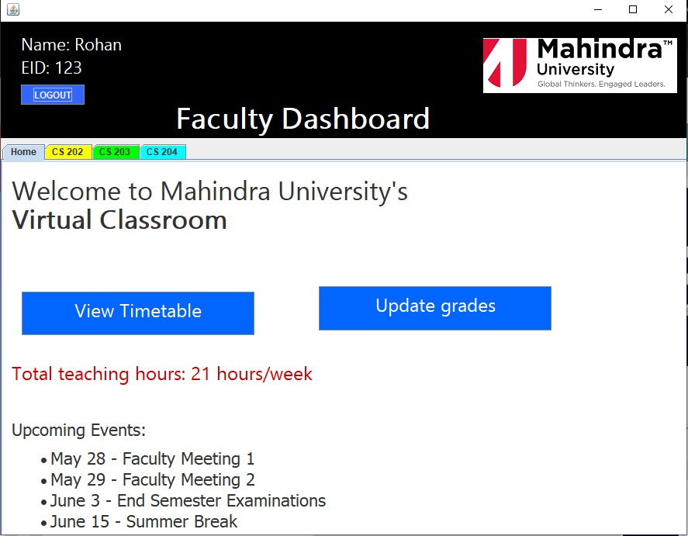
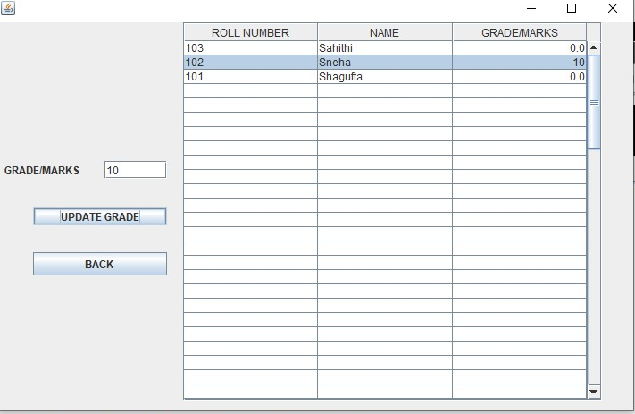
Faculty Dashboard
Add Grades

Slide 25
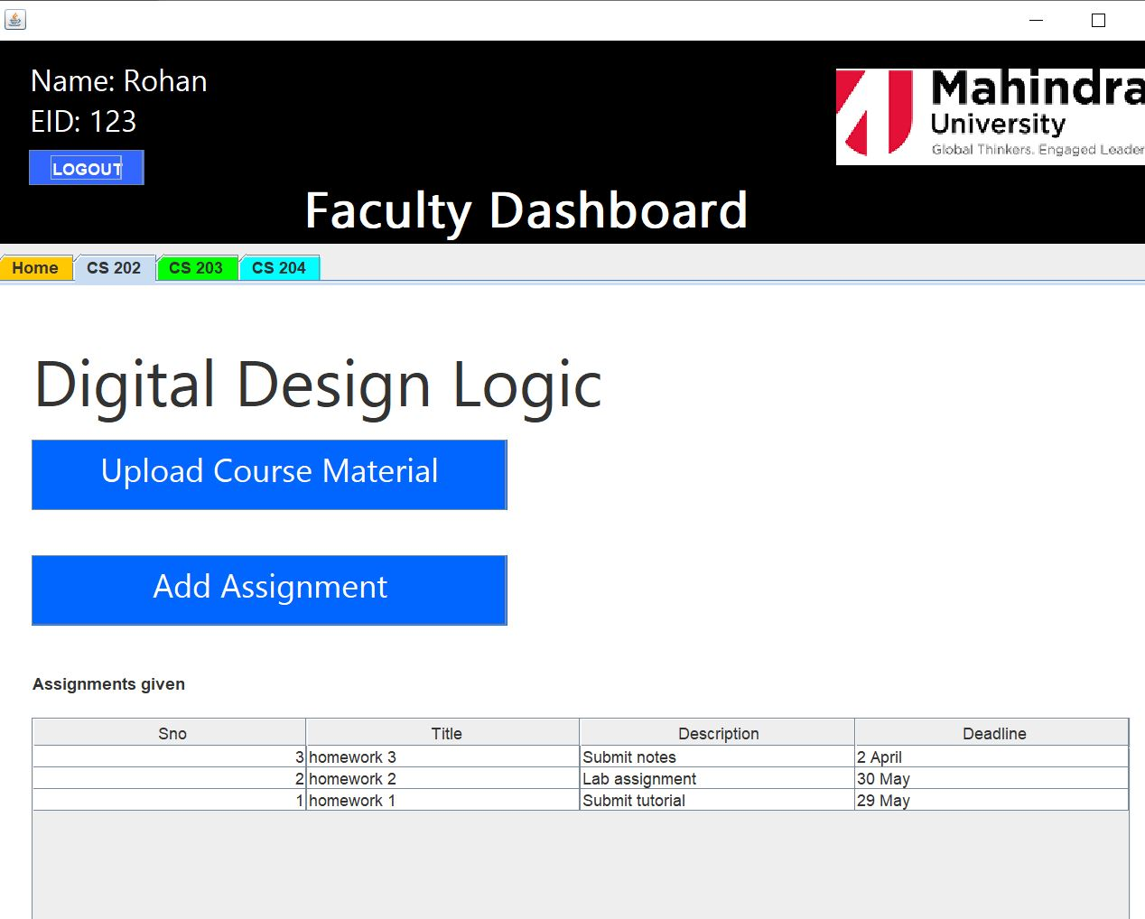
Faculty Courses For a CSE Faculty

Slide 26
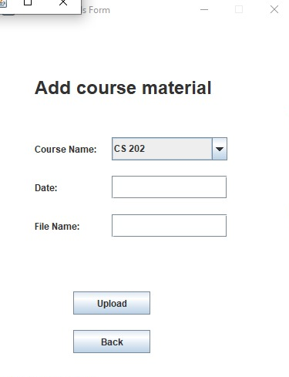
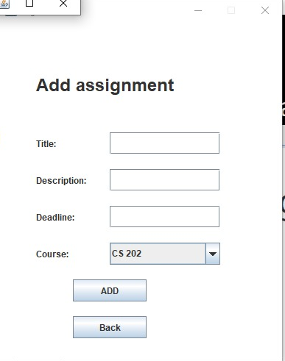

Slide 27

Thank you!

